Slide 1
Telecom Churn Prediction
Using Machine Learning

Slide 2
Group Members Names:
Mr.Siddhant Kishor Kuchekar
Mr.Omkar Navnath Jagdale
Ms.Priyanka Karan Talapalli
Ms.D.kowshiga
Mr.Bhanu Sai Dommeti
Ms.Divya Mahendra Wandhare

Slide 3
Problem Statement:
Telecom companies want to predict customer churn using machine learning. Challenges include data cleaning, feature selection, imbalanced data, model evaluation, and real-time deployment for proactive retention strategies.

Slide 4
Technical Parameter:
Data Preprocessing Parameter | Machine Learning Algorithms | Model Evaluation Metrics | Hyper parameter Tuning | Deployment
Data cleaning | Support Vector machine | Accuracy | Grid search | Pickled model
Handling missing values | Random Forest | Precision | Random search
Outlier detection and removal | Logistics Regression | Recall | Bayesian optimization
Data normalization | Decision trees | F1-score | SMOTE
Feature scaling | Gradient boosting | AUC-ROC

Slide 5
Dataset Details:
Merged the Datasets:
Points | Values
Columns | 21
Rows | 7043
Data types | Object, int64, float64
Missing values | 0
Duplicates values | 0
Churn Data
Merged Dataset
Customer Data
Internet Data

Slide 6
Exploratory Data Analysis(EDA)
Points
Dataset Overview: 7043 entries, 21 columns
No Missing Values: All columns have non-null values
Data Types: Mix of object, int64, and float64
Churn Distribution: Proportion of churned vs. non-churned customers
Customer Demographics: Gender distribution and presence of senior citizens
Service Usage: Phone service, multiple line, internet service, etc.
Contract and Billing: Types of contracts, paperless billing, payment methods
Tenure and Charges: Distribution of customer tenure and monthly charges
Total Charges: Investigate non-numeric values or formatting issues
Correlations: Highlight strong relationships with churn

Slide 7
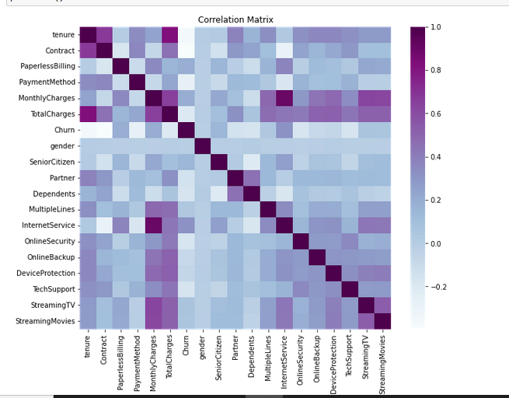
Data Visualization
A heat map of the correlation matrix is plotted using seaborn, displaying correlations between variables in a color-coded manner

Slide 8
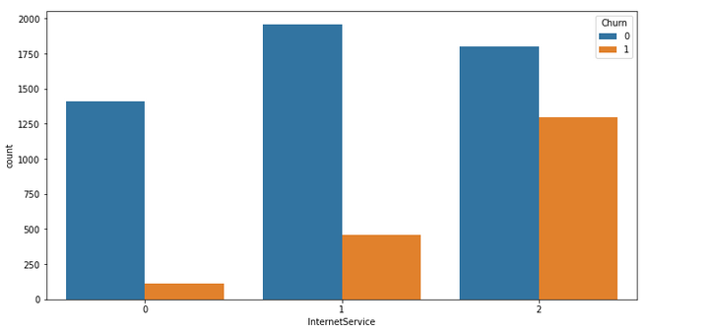
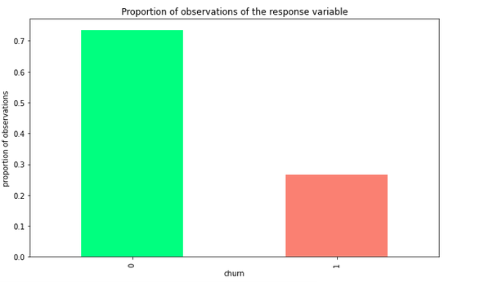
Bar Charts:
A count plot is created using seaborn to visualize the churn rates based on internet service types.
A bar graph is plotted to show the proportion of observations for the response variable "Churn" using normalized value counts.

Slide 9
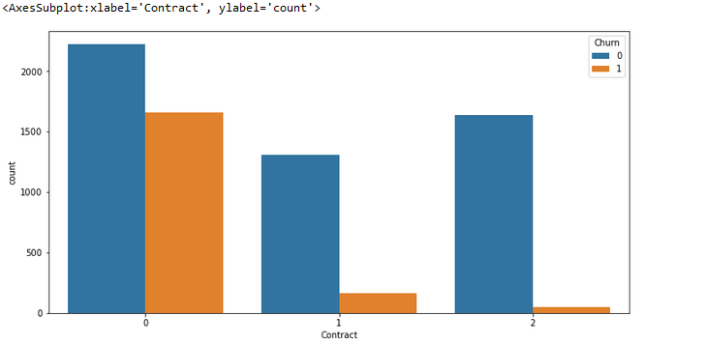
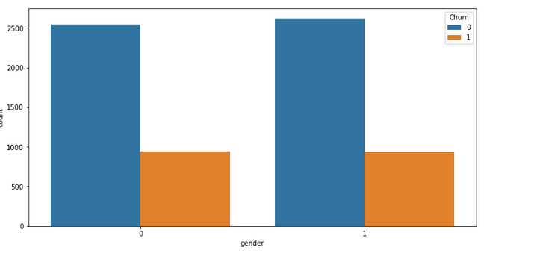
Using seaborn, a count plot is created to depict the churn rates categorized by different contract types.
A count plot is created using seaborn to visually analyze the churn rates based on gender demographics.

Slide 10
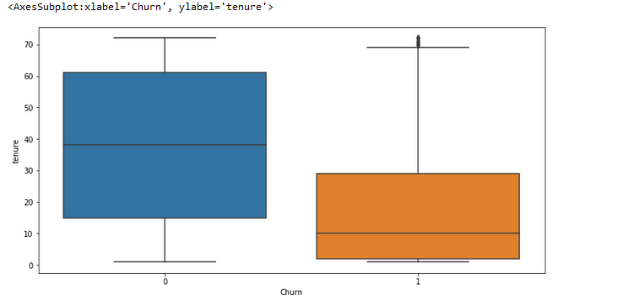
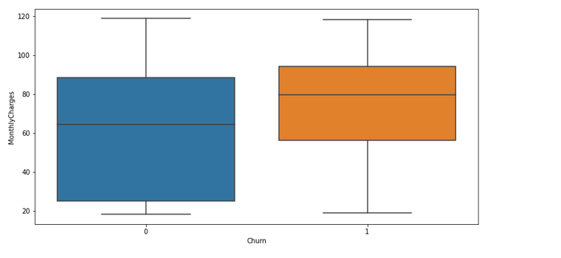
A boxplot is used to visualize the distribution of tenure for churned and non-churned customers.
Using seaborn, a boxplot is generated to compare the monthly charges for churned and non-churned customers

Slide 11
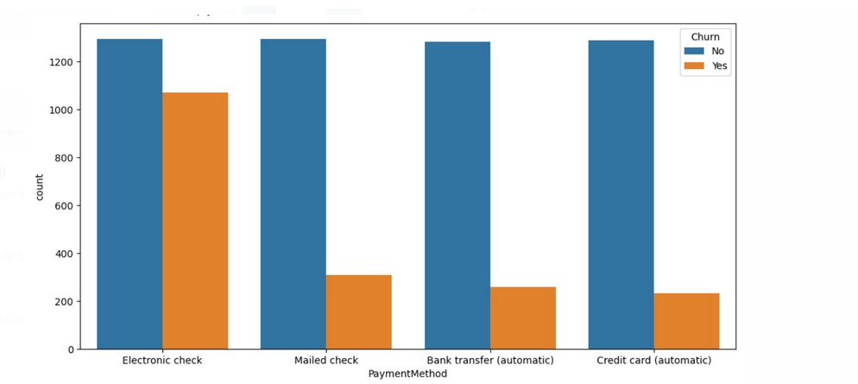
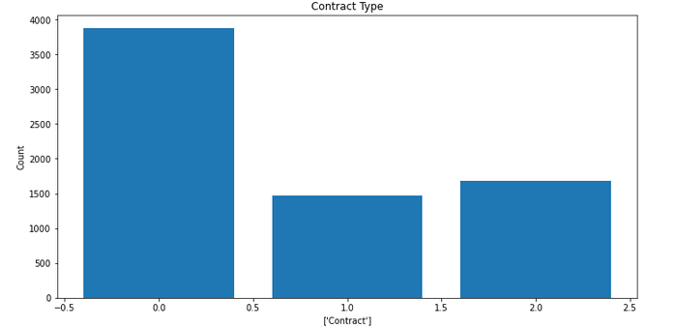
Seaborn's countplot with 'Payment Method' on the x-axis and 'Churn' on the hue parameter is used to analyze the relationship between different payment methods and customer churn.
A visually captivating bar chart is created to showcase the count of different contract types, emphasizing the significance of contract selection.

Slide 12
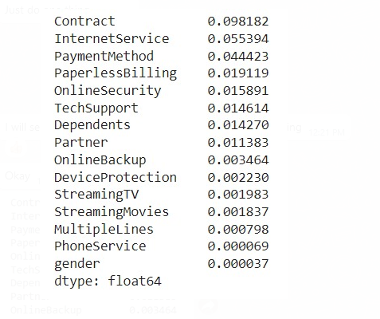
Feature Selection
Feature Selection is vital in the Telecom Churn project, identifying key predictors like tenure, charges, contract type, and demographics through various techniques. It improves model performance, reduces complexity, and provides actionable insights.

Slide 13
Model Building
Model Performance Comparison:
Logistic Regression: Achieved an accuracy of 0.802 and recall of 0.714.
Decision Tree: Achieved an accuracy of 0.799 and recall of 0.670.
Random Forest: Achieved an accuracy of 0.805 and recall of 0.696.
AdaBoost Classifier: Achieved an accuracy of 0.802 and recall of 0.716.
Gradient Boosting Classifier: Achieved an accuracy of 0.797 and recall of 0.704.
XGBoost Classifier: Achieved an accuracy of 0.794 and recall of 0.704.
K-Nearest Neighbors Classifier: Achieved an accuracy of 0.772 and recall of 0.668.
Support Vector Machine Classifier: Achieved an accuracy of 0.801 and recall of 0.720.
Artificial Neural Network Classifier: Achieved an accuracy of 0.807 and recall of 0.726.
These points summarize the performance metrics (accuracy and recall) of different machine learning models applied to the dataset. Logistic Regression achieved the highest accuracy of 0.802, while the Artificial Neural Network Classifier performed the best with an accuracy of 0.807.

Slide 14
Models | Accuracy | Recall
Logistic Regression | 0.802240 | 0.714118
Decision Tree | 0.798794 | 0.669814
Random Forest | 0.805256 | 0.695705
AdaBoost Classifier | 0.802240 | 0.715732
Gradient Boosting Classifier | 0.796639 | 0.704414
XGBoost Classifier | 0.794054 | 0.703745
K-Nearest Neighbors Classifier | 0.772081 | 0.667914
Support Vector Machine Classifier | 0.800948 | 0.719702
Artificial Neural Network Classifier | 0.806549 | 0.726177

Slide 15
Challenges
Challenges | Description
Imbalanced Data | Handling imbalanced dataset
Feature Engineering | Extracting relevant features
Model Selection | Optimizing ML algorithms
Data Preprocessing | Cleaning and preparing data
Real-Time Deployment | Integrating for real-time predictions
Interpretability | Ensuring understandable predictions
Generalization | Building robust models
Ethical Considerations | Addressing biases and privacy
Business Impact | Improving customer retention
Continuous Monitoring | Tracking and adapting models

Slide 16
Model Deployment

Slide 17
Conclusion
In conclusion, the Telecom Churn project aimed to analyze and predict customer churn in the telecom industry. Through exploratory data analysis, feature selection, and model building, valuable insights were gained, leading to effective retention strategies and improved customer satisfaction. Continuous monitoring ensures the model's performance and adaptability to changing dynamics, contributing to long-term business success.

Slide 18
Thank You

